Slide 1
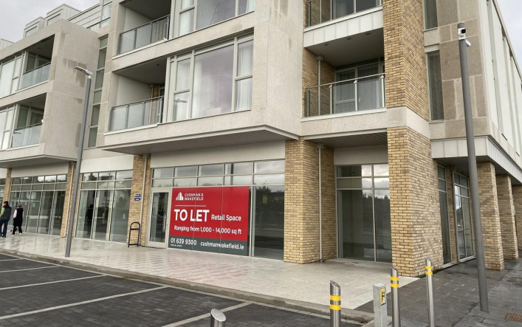

Unit 2, Block D, Marina Village, Greystones, Co. Wicklow
Unit 2, Block D, Marina Village, Greystones, Co. Wicklow
To let
Property Highlights
      Opportunity to acquire retail space located in the highly sought after Marina Village development in Greystones.
      The unit currently measures approx. 2,949 sq ft. (274 sq.m.)
      Suitable for a variety of uses (subject to planning permission).
      Located a short walk from Greystones Village with ample transportation networks serving the area.
Location
Marina Village boasts a convenient location, just a short walk from the lively Greystones Village. The area attracts both local and international visitors due to its range of sports and leisure amenities, including South Beach, Greystones Harbour, and the scenic Bray Head Cliff Walk. It is well served by numerous bus routes, with Greystones DART station located approximately one kilometre south, providing easy access to Dublin City Centre and surrounding areas.
Contact
Karl Stewart
Email: Karl.Stewart@cushwake.com
Tel: +353 1 639 9347
Anna May Gilsenan
Email: Annamay.Gilsenan@cushwake.com
Tel: +353 86 833 9396

Slide 2
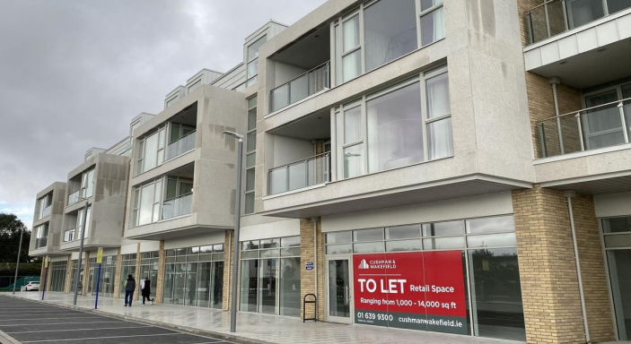
Unit 2, Block D, Marina Village, Greystones, Co. Wicklow
Property Description
The unit extends to 2,949 sq ft. (274 sq.m.) Internally the unit is in white box condition,
with suspended ceilings recessed lighting and white painted walls. The unit
boasts a fully glazed shop front, ensuring abundant natural light. The unit has
potential to be split, subject to planning
Rent
Rent is on application.
Viewings
Strictly by appointment only through sole leasing agents Cushman & Wakefield.
Service Charge
Service Charge for this property is approximately €1.12 per sq.ft.
Amenity Charge
The amenity charge is approximately €1.00 per sq.ft.
Cushman & Wakefield
2 Cumberland Place Fenian Street Dublin 2
Ireland
+353 (0)1 639 9300
Rates
Commercial rates for this property are available on enquiry
BER:

